Slide 1
DS3DGS: Dynamic Specular 3D Gaussian Splatting
Chen-Wei Chang
Zheng-Xiu Zhuo

Slide 2
Schedule

Slide 3
Outline
01
Purpose
02
Related work
03
DS3DGS Overview
04
Experiment
05
Conclusion

Slide 4
Purpose
Our goal
Input :
monocular RGB video of a dynamic scene
Output :
space-time view synthesis

Slide 5
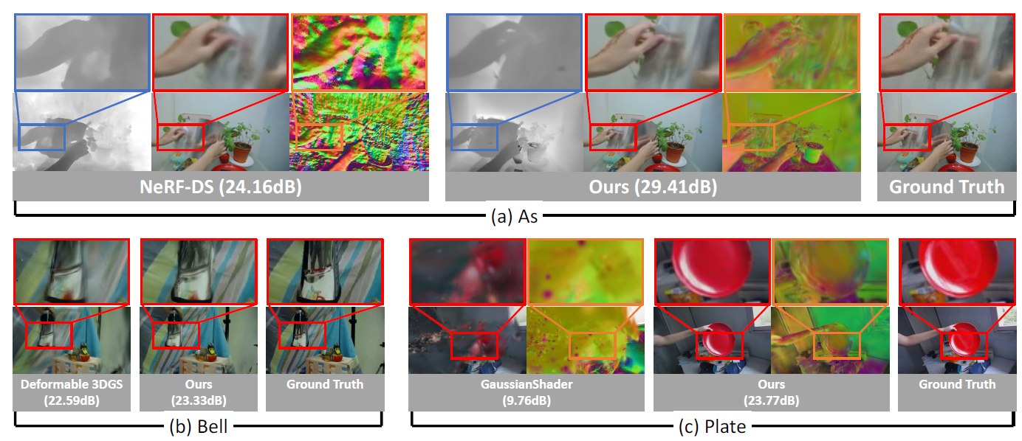
Our goal
Purpose

Slide 6
Deformable 3D Gaussians for High-Fidelity Monocular Dynamic Scene Reconstruction (CVPR 2024) using 3D Gaussians in canonical space with a deformation field
Related work
GaussianShader: 3D Gaussian Splatting with Shading Functions for Reflective Surfaces (CVPR 2024)
integrate Gaussian splatting with physically-based rendering(PBR)
Notes:
Fine-tuning is the process of adjusting the parameters of a pre-trained large language model to a specific task or domain. Although pre-trained language models like GPT possess vast language knowledge, they lack specialization in specific areas. Fine-tuning addresses this limitation by allowing the model to learn from domain-specific data to make it more accurate and effective for targeted applications.

Slide 7
While 3DGS has significantly improved the efficiency and quality of 3D scene reconstruction, it does not address certain limitations in modeling specular dynamic scenes, and its extensions cannot simultaneously handle both dynamic scenes and specular object rendering.
Related work
Dynamic Scene Reconstruction (base on 3DGS)
Deformable 3DGS (CVPR 2024)、4DGS (CVPR 2024) 、SC-GS (CVPR 2024) 、GauFRe
Reflective Object Rendering (base on 3DGS)
GaussianShader (CVPR 2024) 、GS-IR (CVPR 2024) 、Spec-Gaussian
Both (base on NeRF)
NeRF-DS (CVPR 2023)
Both (base on 3DGS)
NO

Slide 8
Related work
Contribution
We propose a physically-based rendering (PBR) approach that combines with a deformation field, allowing 3D Gaussians to effectively represent dynamic specular scenes. By integrating the normal into the deformation field, the model can adapt to specular color changes over time.
We introduce the residual correction term for normals, which accurately adjusts them during deformation to ensure precision.
Through a coarse-to-fine training strategy, the geometry of the entire scene is more complete, which allows for accurate prediction of specular color
Leveraging the efficiency of 3DGS, we are the first framework to extend 3DGS for dynamic specular scenes. Additionally, our quantitative and qualitative results evaluated on our labeled dynamic specular masks demonstrate that our method outperforms the current state-of-the-art method.
Notes:
它們分別觀察了in-distribution (ID) 以及out-of-distribution (OOD)，這兩個distribution 分別代表著算術推理以及常識推理的distribution，在常識推理中training dataset是從所有的常識推理的datasets的datasets所組成的，在算數推理中，training dataset只由GSM8K跟AQuA組成，透過研究的結果我們可以發現透過in-distribution這樣的方式來微調較小規模的LLM，能夠達到不輸ChatGPT的效能。而out-of-distribution我們可以看到透過像LoRA這樣的方式進行微調，也可以達到不錯的效果，證明在這種out-of-distribution的微調方式下，微調較小規模的LLM是可行的，不過對於像GSM8K跟AQuA這種比較複雜問題的datasets，微調的效果跟ChatGPT相比，還是有肉眼可見的差異，因此在這種複雜的數學問題上的表現優化，應該是未來一個很重要的研究方向。

Slide 9
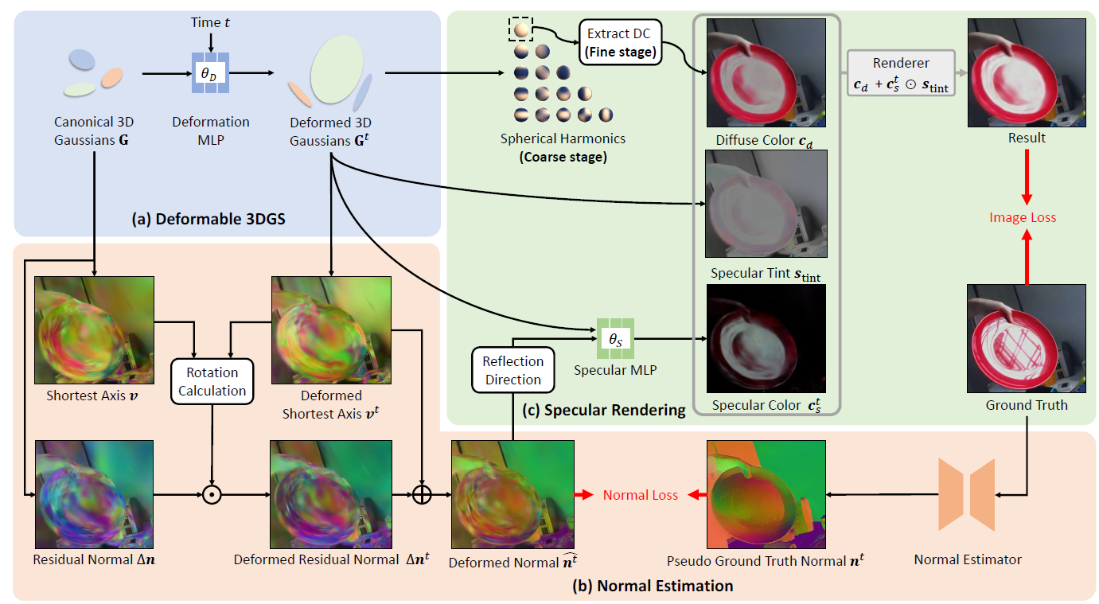
Overall framework
DS3DGS Overview

Slide 10
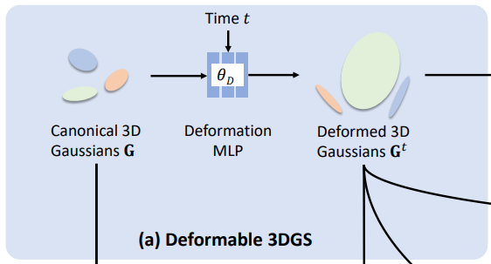
Deformed 3D Gaussians
DS3DGS Overview
(1)
(2)

Slide 11
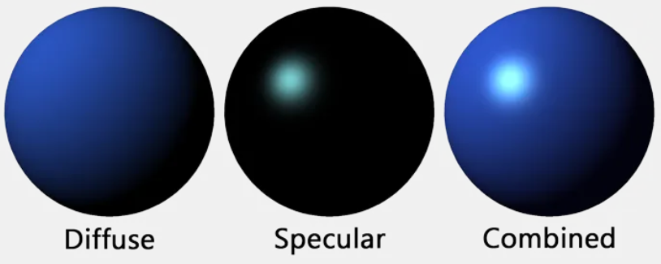
Render color
DS3DGS Overview

Slide 12
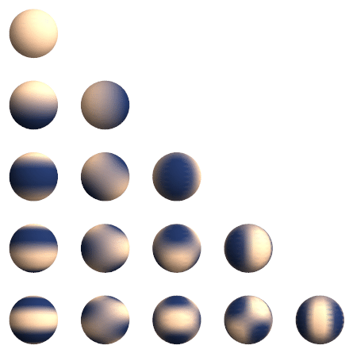
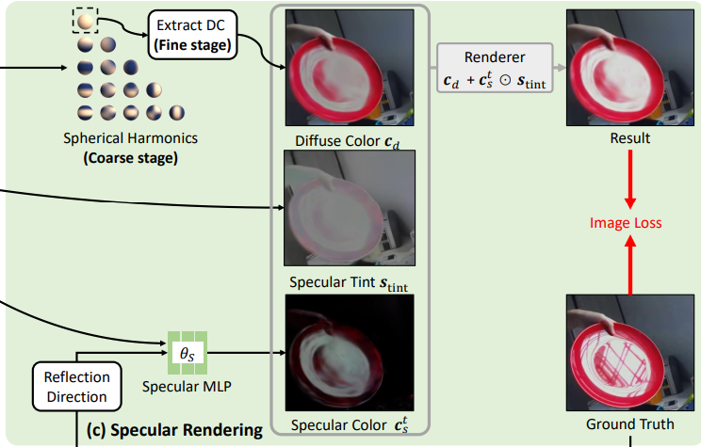
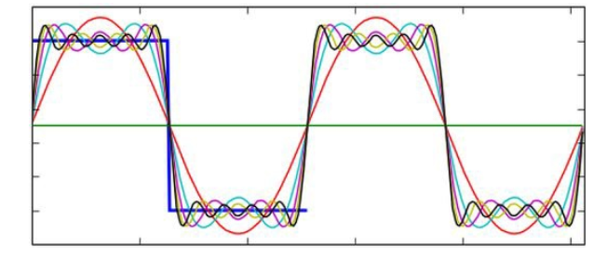
Diffuse color
DS3DGS Overview
Visual representations of the first few real spherical harmonics.

Slide 13
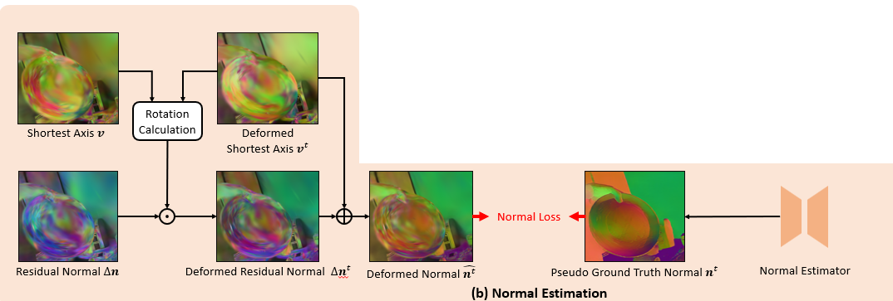
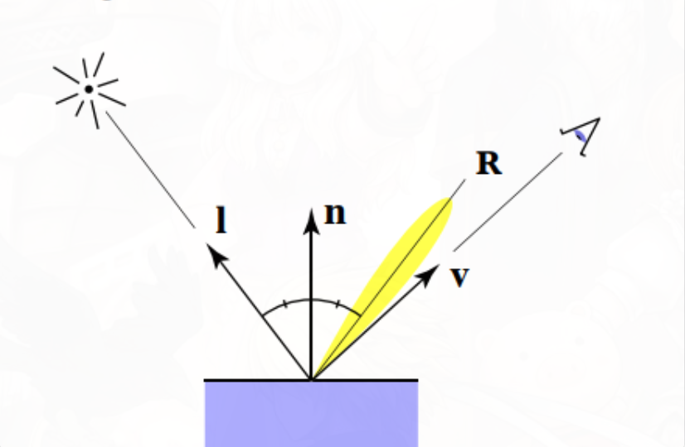
Specular color : Normal Estimation
DS3DGS Overview
Notes:
https://blog.csdn.net/lbwnbnbnbnbnbnbn/article/details/125696165

Slide 14
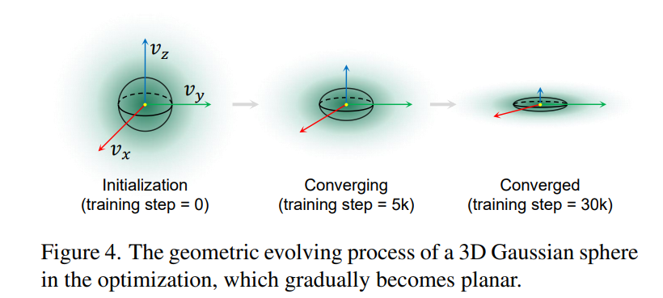
Specular color : Normal Estimation
DS3DGS Overview
(6)
(7)

Slide 15
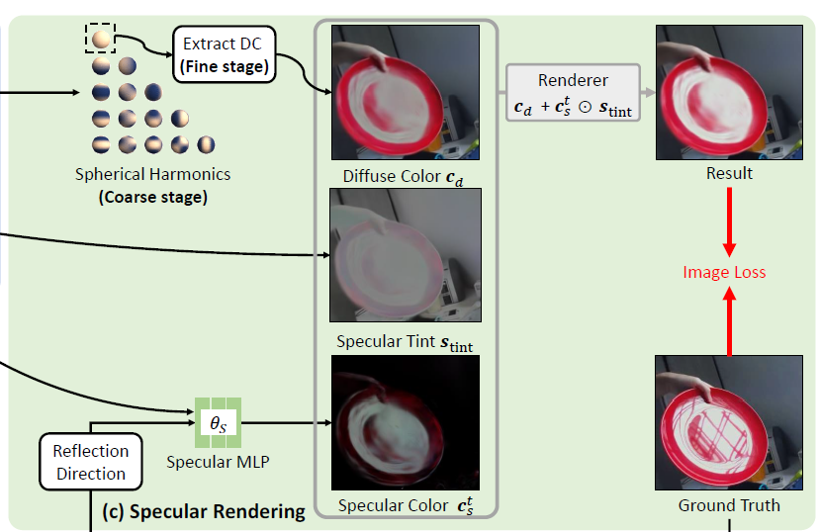
Specular color : Reflection Direction
DS3DGS Overview
(8)
Notes:
environment map 並不適合模擬time varient以及背景複雜的環境，所以我們使用簡單的Specular MLP，講解Specular MLP的input、output，以及利用roughness乘以gaussian的scale來模擬每個gaussian的表面粗糙度。

Slide 16
Specular color
DS3DGS Overview
(9)

Slide 17
Specular Rendering
DS3DGS Overview
(10)

Slide 18
Coarse-to-fine training strategy
DS3DGS Overview
1. Static stage: we train for 3000 iterations,and we train only the static parts of the 3DGS to stabilize the position of the 3D Gaussian components.
2. Dynamic stage: we optimize the deformation parts of the 3DGS until the 11,000 iterations to ensure stability at each dynamic point.
3. Specular stage: we begin optimizing our entire model until the 24,000 iterations.

Slide 19
Losses
DS3DGS Overview
(11)
(12)
(13)
(14)

Slide 20
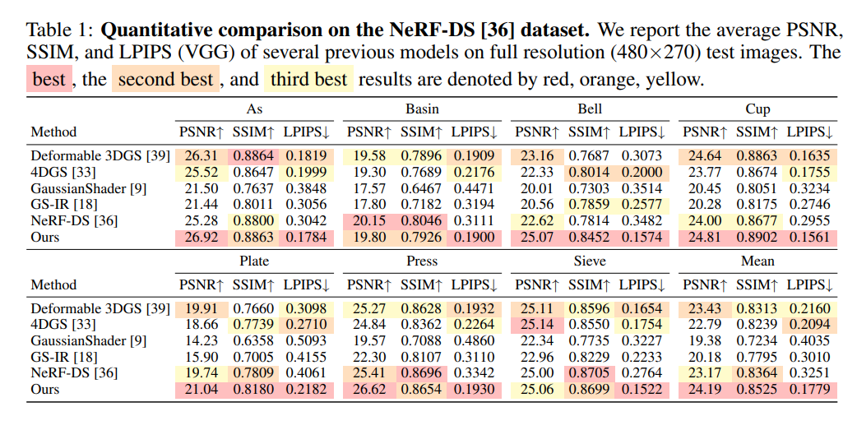
Results analysis
Experiment

Slide 21
Results analysis
Experiment

Slide 22
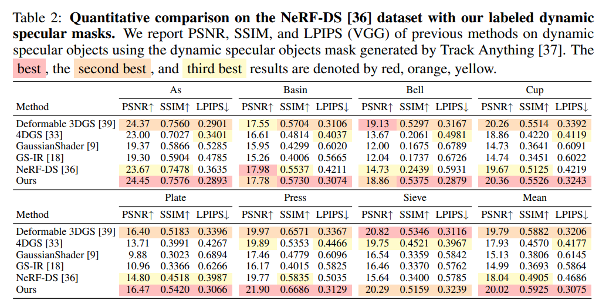
Results analysis
Experiment

Slide 23
Results analysis
Experiment

Slide 24
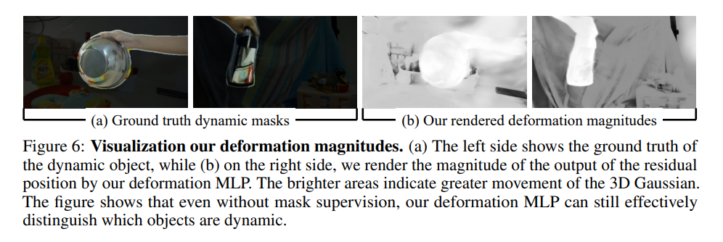
Results analysis
Experiment

Slide 25
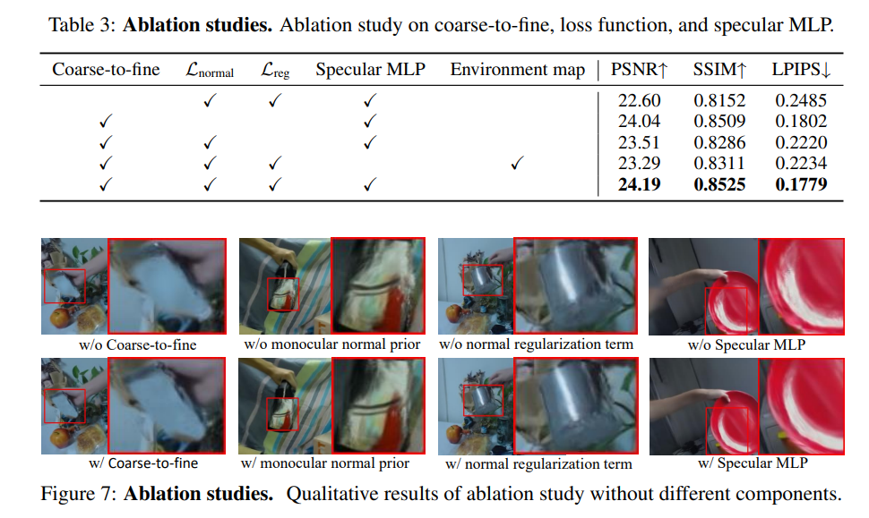
Results analysis
Experiment

Slide 26
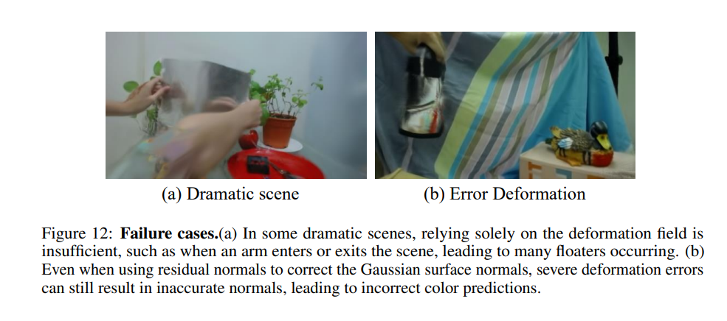
Conclusion
Feature work
Notes:
它們分別觀察了in-distribution (ID) 以及out-of-distribution (OOD)，這兩個distribution 分別代表著算術推理以及常識推理的distribution，在常識推理中training dataset是從所有的常識推理的datasets的datasets所組成的，在算數推理中，training dataset只由GSM8K跟AQuA組成，透過研究的結果我們可以發現透過in-distribution這樣的方式來微調較小規模的LLM，能夠達到不輸ChatGPT的效能。而out-of-distribution我們可以看到透過像LoRA這樣的方式進行微調，也可以達到不錯的效果，證明在這種out-of-distribution的微調方式下，微調較小規模的LLM是可行的，不過對於像GSM8K跟AQuA這種比較複雜問題的datasets，微調的效果跟ChatGPT相比，還是有肉眼可見的差異，因此在這種複雜的數學問題上的表現優化，應該是未來一個很重要的研究方向。

